Slide 1

ECE 419/619 Electric Machines and Drives Permanent-Magnet Synchronous Machines (rotor reference frame)

Slide 2
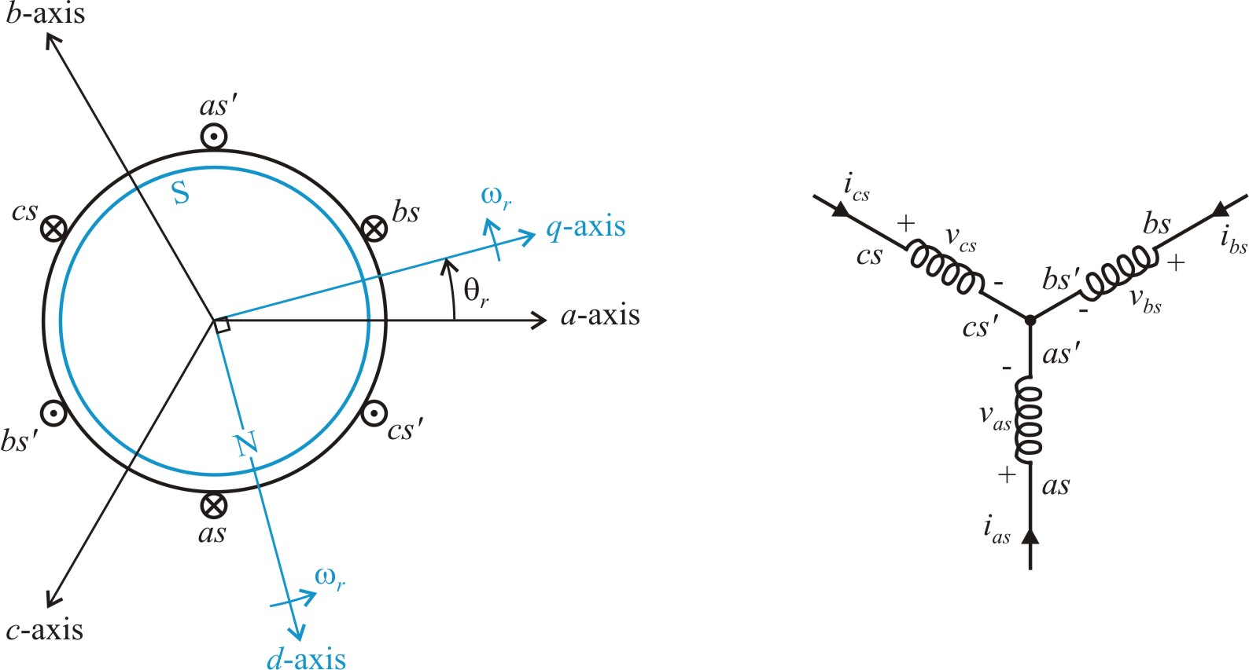
Permanent Magnet Synchronous Machines (PMSMs), Chapter 6
winding connection
motor construction
assume: 1. Round rotor (magnetically)
2. Sinusoidal flux linkages

Slide 3
PMSM Equations
machine coil variables
flux linkages

Slide 4
Coil Voltage Equations
machine variables
rotor reference frame, q-d variables

Slide 5
Flux Linkage Expressions
compress equations

Slide 6
Transform Flux Linkages
inductance
define
magnet flux linkage

Slide 7
Flux Linkage Equations in the Rotor Reference Frame
compared to a-b-c variables:
no coupled terms and no rotor position dependence

Slide 8
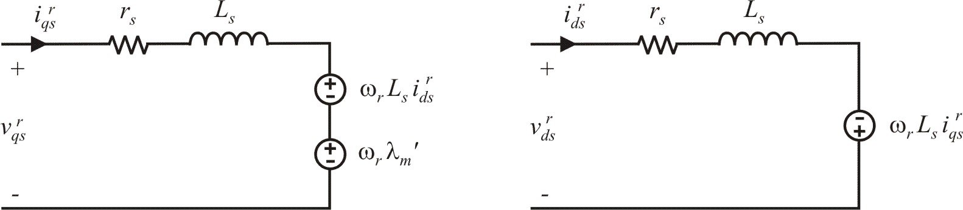
Equivalent Circuit Model
substitute flux linkage equations into voltage equations
q-axis circuit
d-axis circuit

Slide 9
Torque Equation from Power

Slide 10
Torque Equation from Power

Slide 11
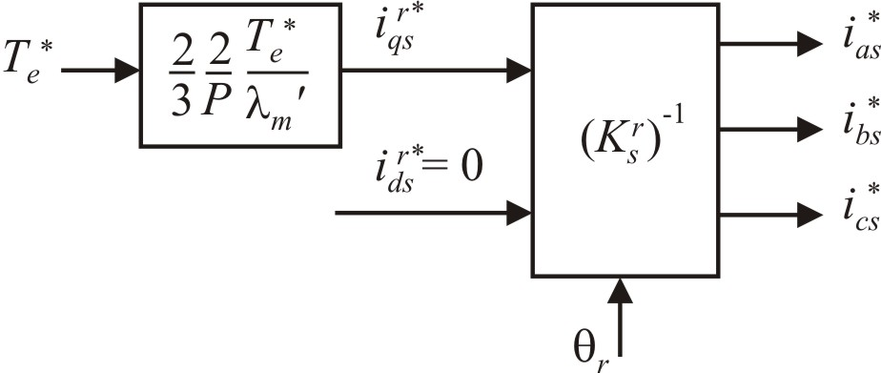
Torque Control
Note: in a-b-c variables
in q-d-0 variables
torque control

Slide 12
PMSM Model
The PMSM can be modeled with a fairly straightforward resistance, inductance, and back-emf term in each phase.
If the zero sequence current can be neglected, the q-d model represents the machine as a two-phase circuit with dc quantities in the steady-state. The two circuits are coupled by back-emf terms.
The torque equation in the q-d model is simplified compared to the machine-variable (a-b-c) model. This property will be used for developing a torque control.
The q-d model also leads to simple control in other systems such as induction machines, active rectifiers, and active filters.

Slide 13
PMSM Steady-State Equations
round rotor machine
constant
use notation
with

Slide 14
Steady-State Solutions
solving for voltages
solving for currents

Slide 15
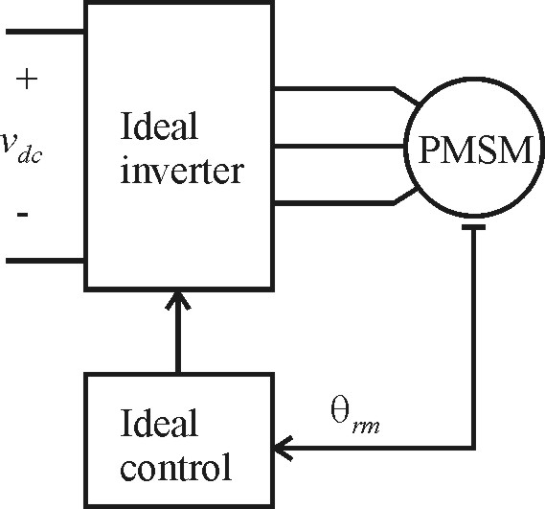
PMSM with Ideal Drive (Steady-State)
inverter voltages
resulting currents

Slide 16
Ideal Drive Calculations with φ_{v} = 0

Slide 17
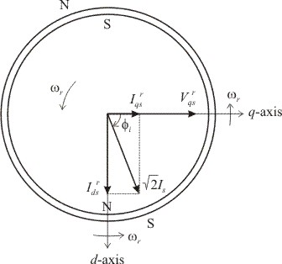
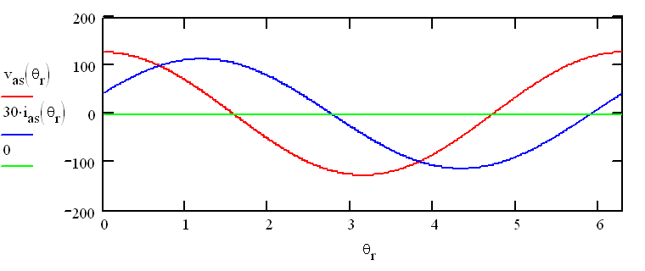
PMSM Steady-Sate Example φ_{v}=0

Slide 18
Ideal Drive Calculations with φ_{i} = 0

Slide 19
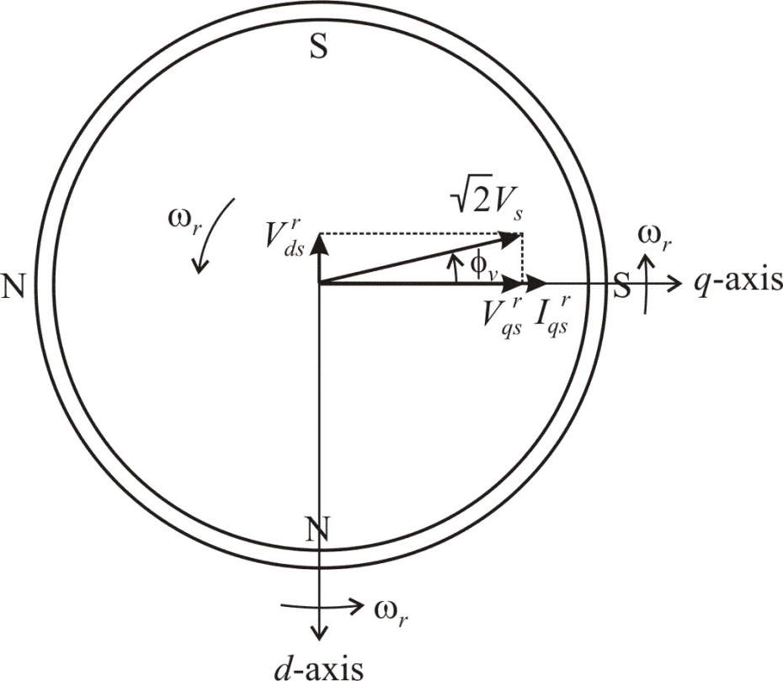
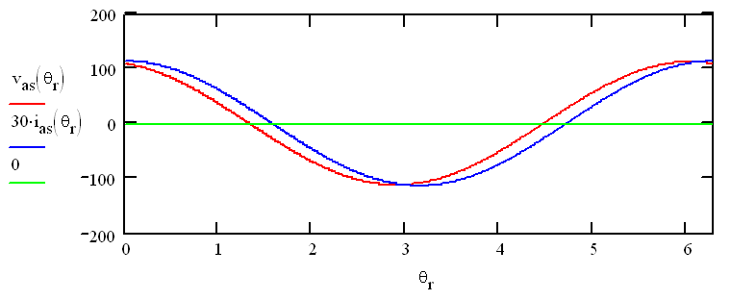
PMSM Steady-Sate Example with φ_{i} = 0

Slide 20
PMSM Steady-State Operation
Steady-state calculations are straightforward since q-d variables are constant in the rotor reference frame.
The PMSM drive adjust the applied voltages as a function of the measured rotor position angle.
Steady-state equations were used to observe PMSM drive performance.

